Slide 1
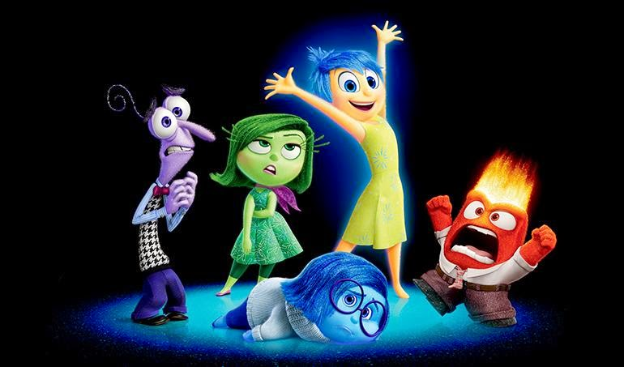

Slide 2
Colour the emotions appropriately

Slide 3
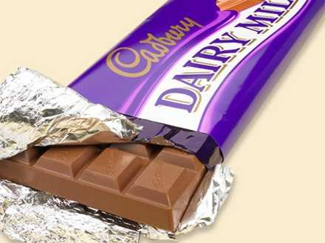
Persuade me!

Slide 4
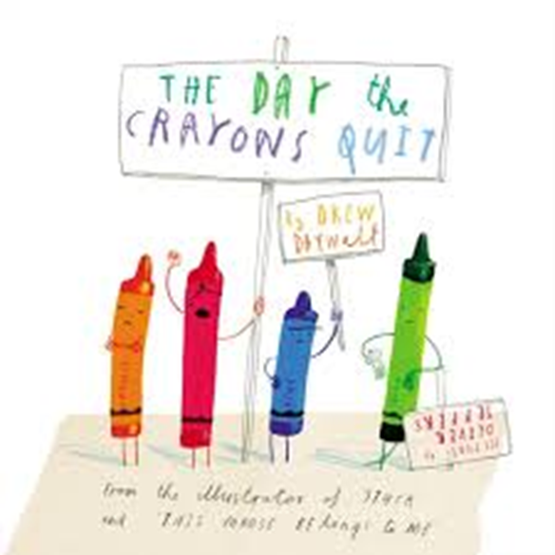
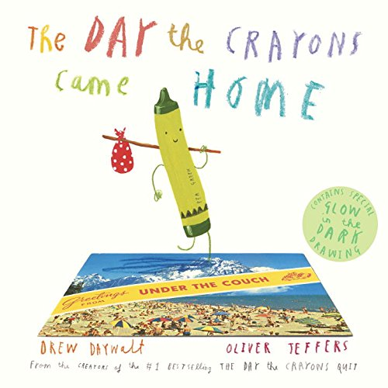

Slide 7
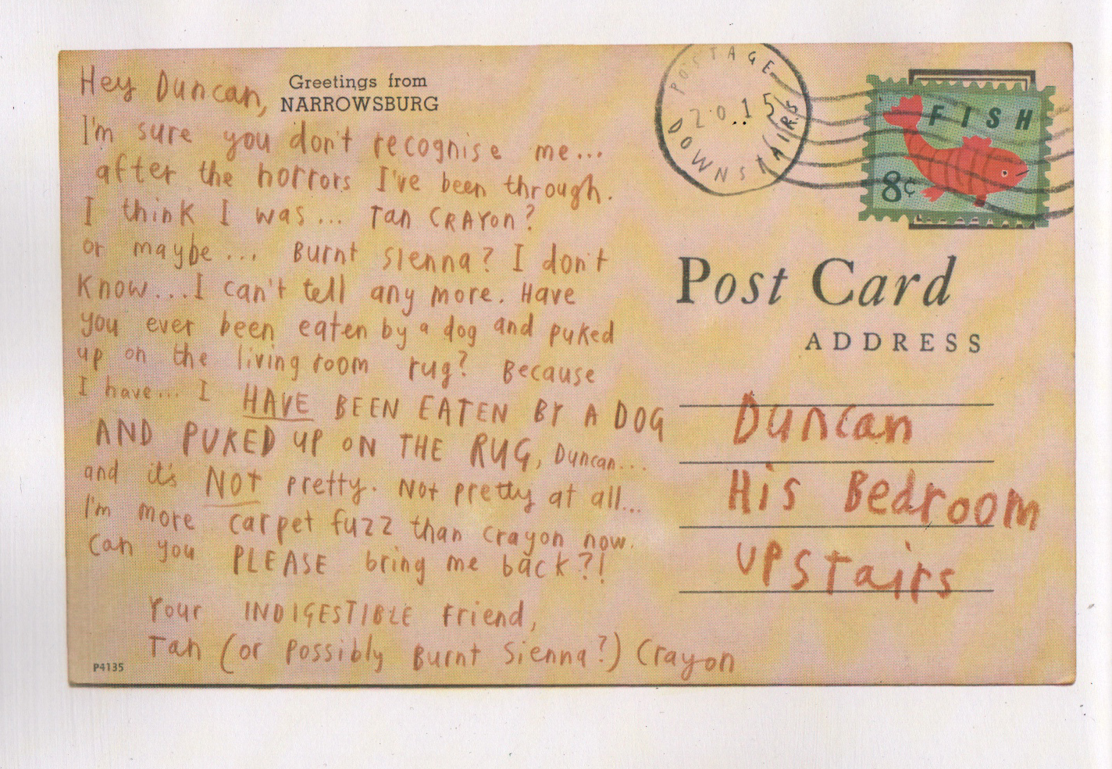

Slide 8
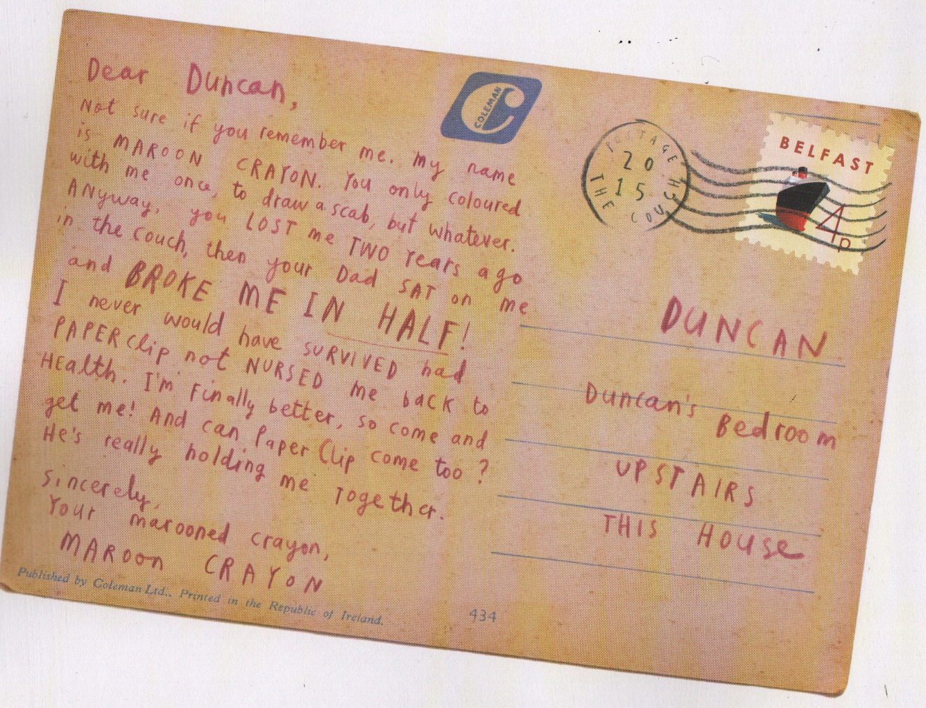

Slide 9
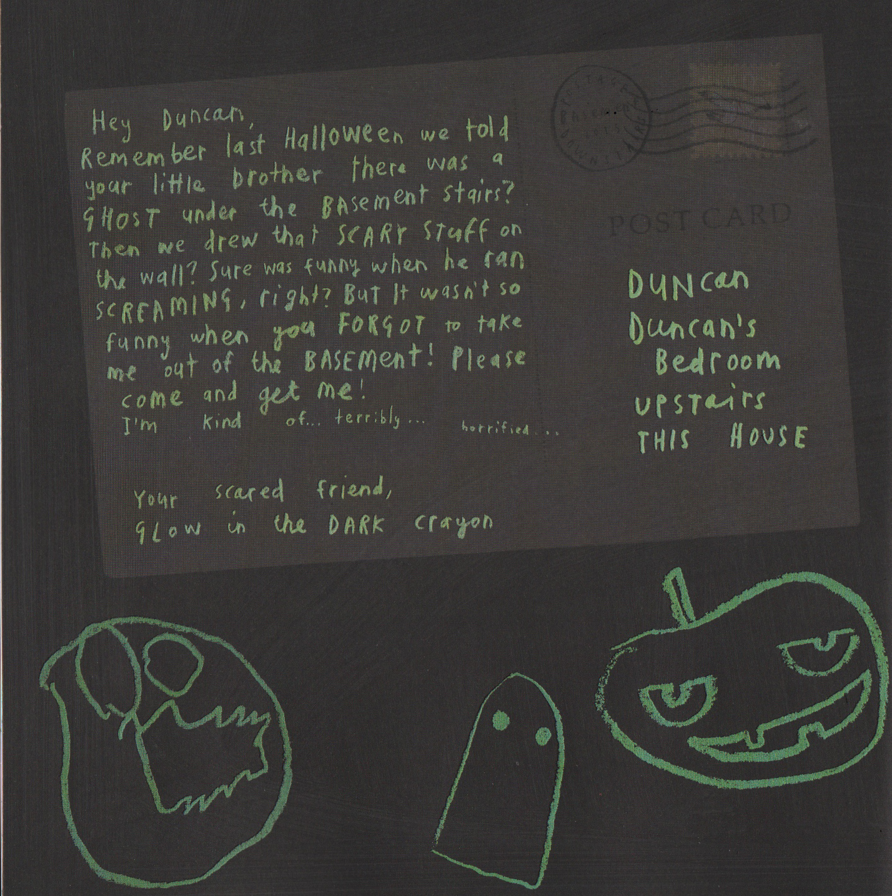

Slide 10
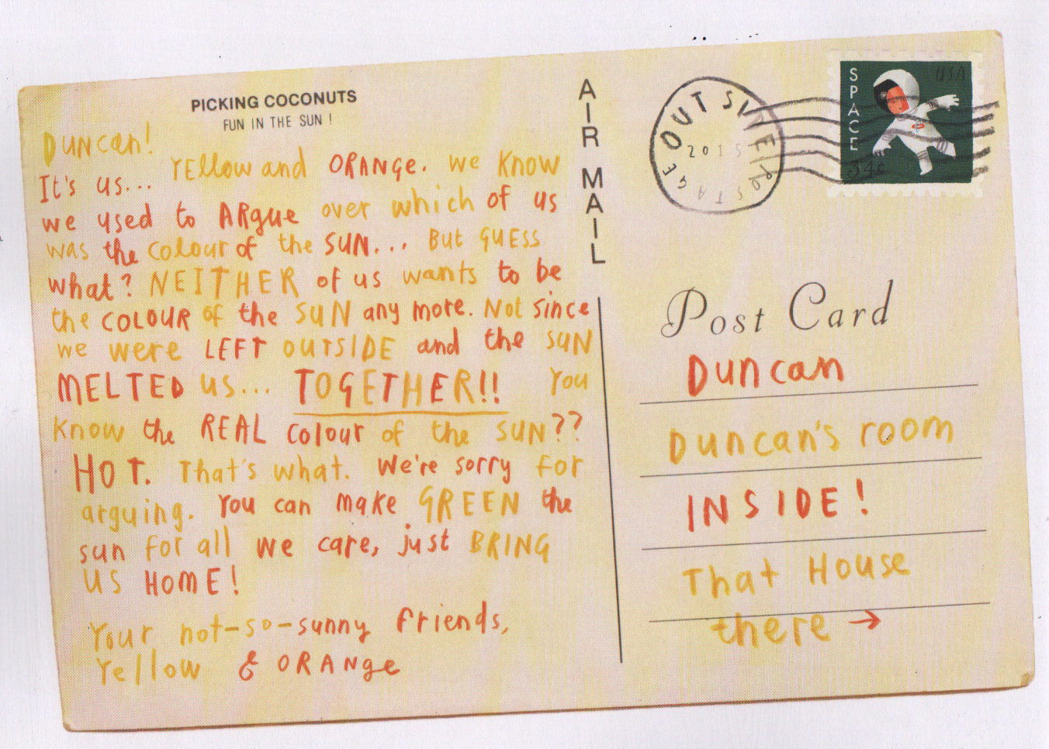

Slide 11
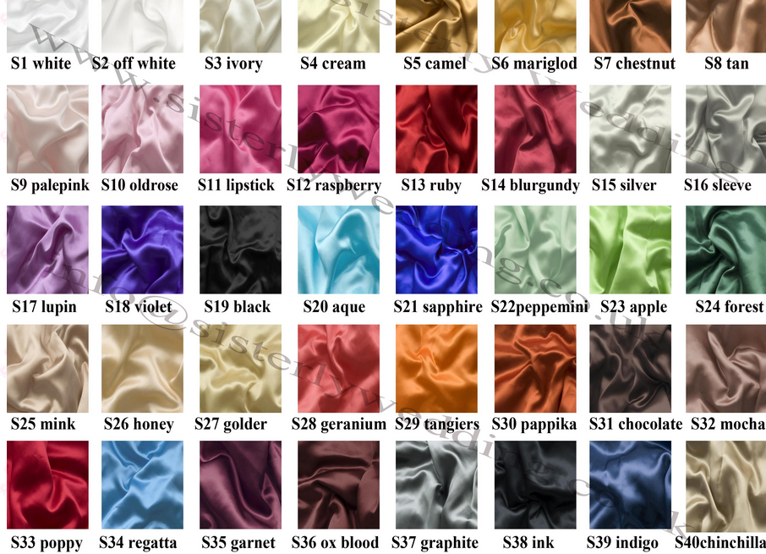

Slide 12
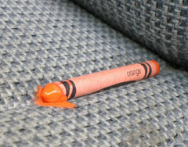
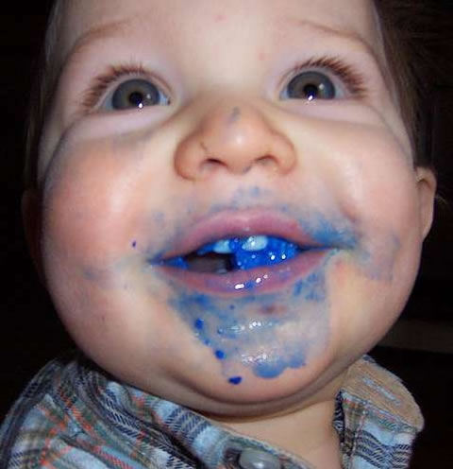
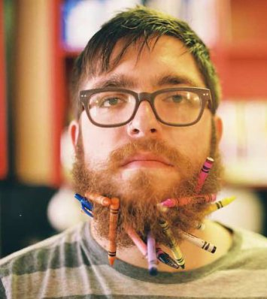
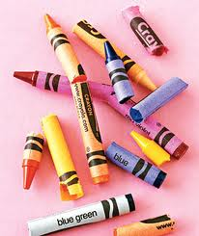
What could happen?
lost????? melted
stuck
chewed
qqqqqqqqqq
broken

Slide 13
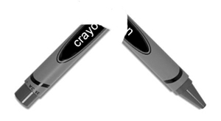
DUNCAN!
How could you? You betrayer…life-taker….brute. I thought we were friends because of all the hours spent colouring Batman together. How wrong I was! I helped you reach the highest echelons of artistic expression with my subtle shading and intense mood creation. What did you give me in return? A broken back. A BROKEN BACK! Last night, in a violent rage, you snapped me like a twig and discarded me in the bin. It wasn’t my fault that you coloured over the lines and ruined your ‘masterpiece’!. Who do you think you are? MONET!
Retrieve me immediately or you will be hearing from my lawyer and it won’t be pretty.
Your vengeful, soon-to-be ex-friend,
Ink Crayon

Slide 14
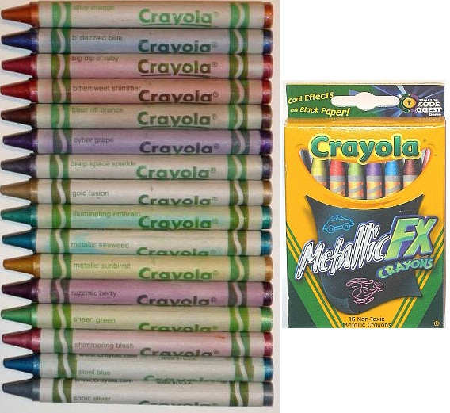
Finding some great colours!

Slide 15
Purpose of the post-card – lost, forgotten, broken or neglected!
Colour | Reason for writing
Maroon | Complaint about being lost and demand to be rescued.
Pea green | Complaint about everyone disliking his name and informing him that he is leaving! Plea to have the door opened to enable his adventure to begin. Explanation about the return of Esteban.
Neon red | Complaint about being left behind. 2 postcards informing him of his journey back.
Orange/Yellow | Upset about being left in the sun and plea about being brought home.
Tan/Burnt Sienna | Shocked after being eaten and ‘puked’ up by a dog.
Glow in the dark | Wants to come home after being left in the dark.
Gold | Complaint about being stuck in a pencil sharpener.
Turquoise | Begging to help him get freed from a sock.
Big chunky | Begging him to save him from his baby brother.
Brown | Demanding that he draws something else!

Slide 16
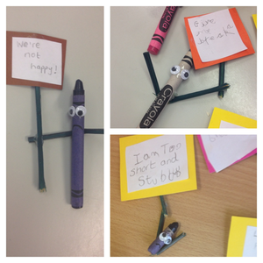
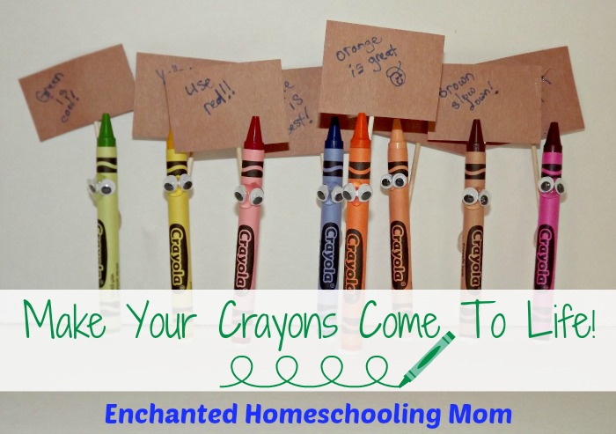
Bring the characters to life!

Slide 18
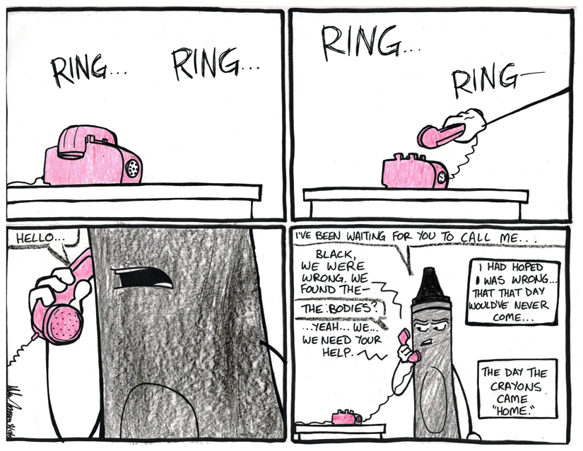

Slide 19
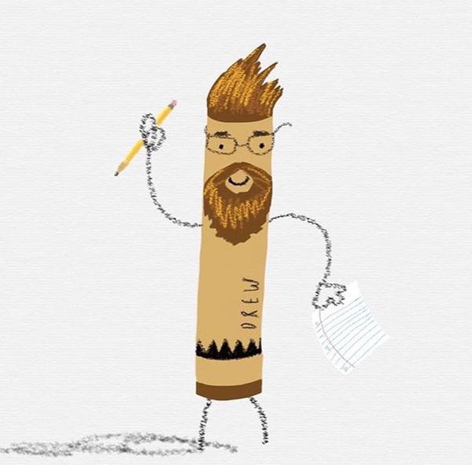

Slide 20
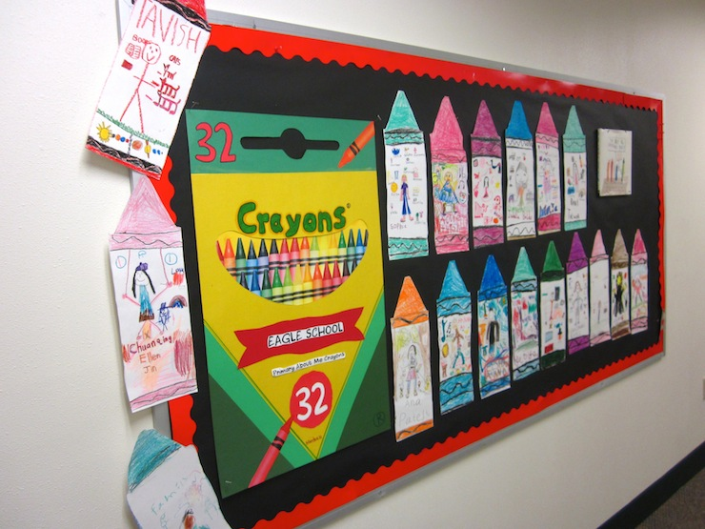

Slide 21
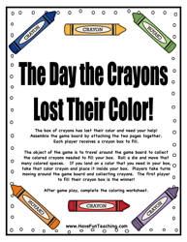

Slide 22
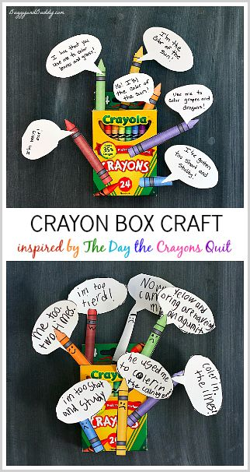

Slide 23
