Slide 1
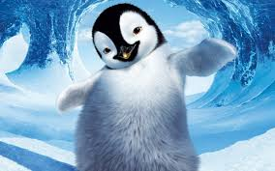

Slide 2
Penguin
The penguin's a bird that cannot fly But can swim like a torpedo! And on the ice It looks so nice Dressed in its own tuxedo!

Slide 3
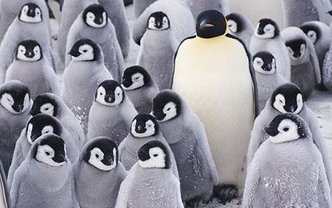

Slide 4
Ten Little Penguins
One little, two little, three little penguins, Four little, five little, six little penguins, Seven little, eight little, nine little penguins, Ten little penguin chicks.

Slide 5
Six Little Penguins
Six little penguins off an iceberg did dive, One bumped his beak, then there were five.
Five little penguins swam the ocean floor, One saw a whale, then there were four.
Four little penguins spun around, whee-ee! One spun off, then there were three!
Three little penguins, with nothing to do, One went fishing, then there were two.
Two little penguins, having lots of fun, One fell of, then there was one.
One little penguin, when the day was done, Went home to sleep, then there were none.

Slide 6
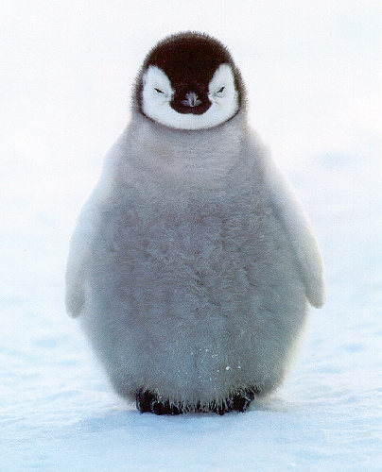
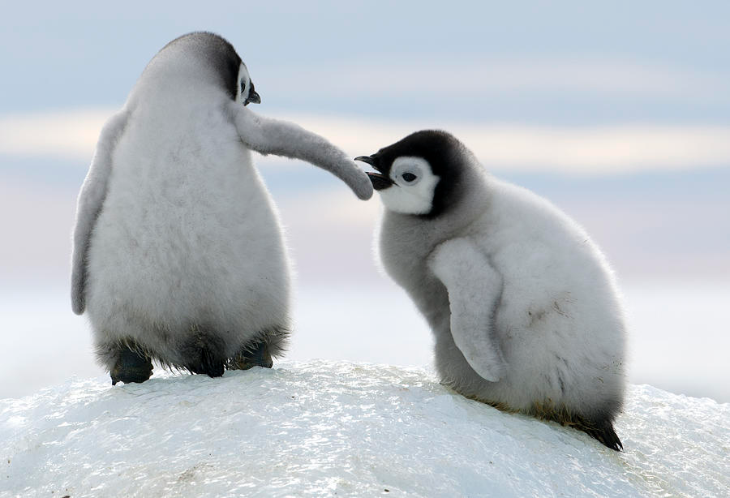

Slide 7
Penguin parade
Waddle, waddle, waddle From side to side Penguins go a-walking Slip, slip, slide, slide. With a funny jump The penguins dash Down to the water Splash! Splash! Splash! Splash! Waddle from the water With a rock n' roll Penguins go parading On a wintry stroll.

Slide 9
Penguin Shuffle
Penguins shuffle, shuffle, shuffle
to the left, left, left Penguins shuffle, shuffle, shuffle
to the right, right, right, Give a little wiggle Give a little hop Waddle round the iceberg Never want to stop!

Slide 10
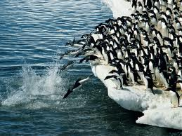

Slide 11
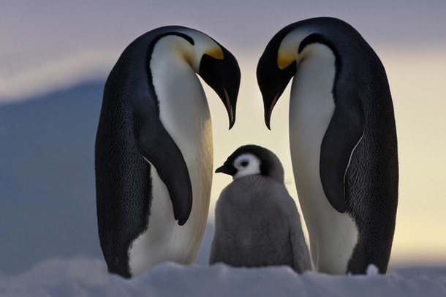

Slide 12
I’m a little penguin
I'm a little penguin round and fat Here’s my beak, and here’s my hat. Winter days are coming, hear me shout, "Please don't toss my mittens out!"
I'm a little penguin black and white. Short and wobbly, an adorable sight. I can't fly at all, but I love to swim. So I'll waddle to the water and dive right in.

Slide 13
Little Penguin
When all the seals were sleeping and the sun
had gone to bed Up jumped the penguin and this is what he said!
I'm a wiggly, waggly penguin with a flippy floppy
wing, I can shake my flippers like this but I really
just can’t sing.
When all the whales were snoozing and the moon was behind the cloud Up jumped the penguin and shouted very
loud
I'm a wiggly, waggly penguin with a flippy floppy wing I can shake my flippers like this but I really just
can’t sing.

Slide 14
